Slide 1
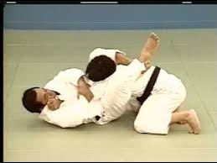
Ude – Hishigi – Sankaku – Gatame Arm Crush Triangular Hold

