Slide 1
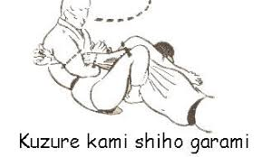
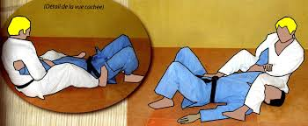
Kuzure - Kami – Shiho – Garami Upper Four Quarters Armlock

