Slide 1
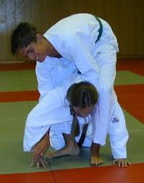
Ohten – Gatame Lateral Turning Armlock (Rolling over into Ude Hishigi Juji Gatame)

