Slide 1
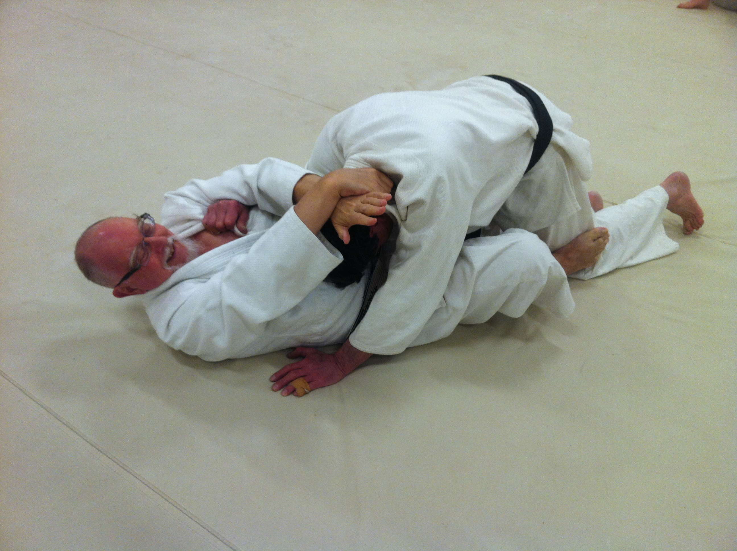
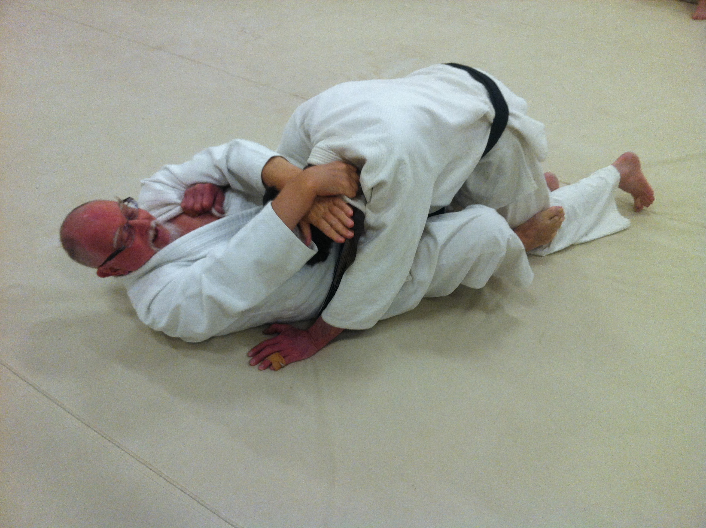
Kata – Ha – Jime (From the Front) Single Wing – Strangle
Grip opposite collar (eri) then around the head and under your own forearm.

