Slide 1
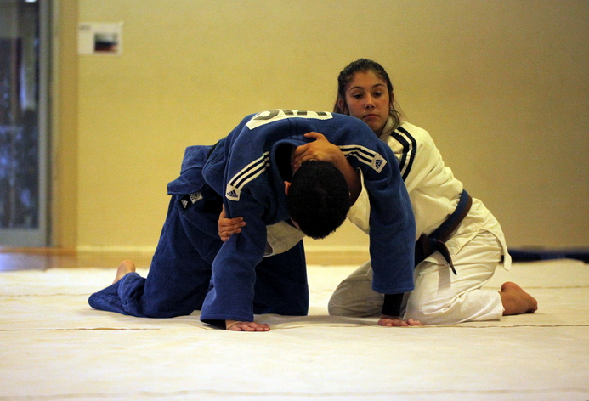
Turnover: Half Nelson

