Slide 1
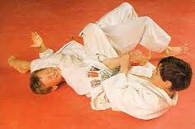
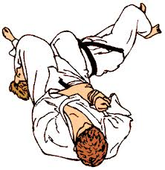
Ude – Hishigi – Juji – Gatame Cross – Armlock

