Slide 1
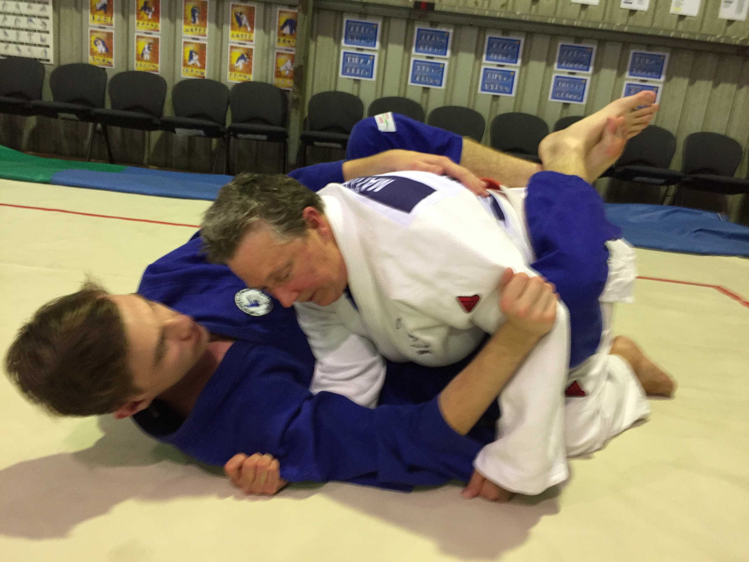
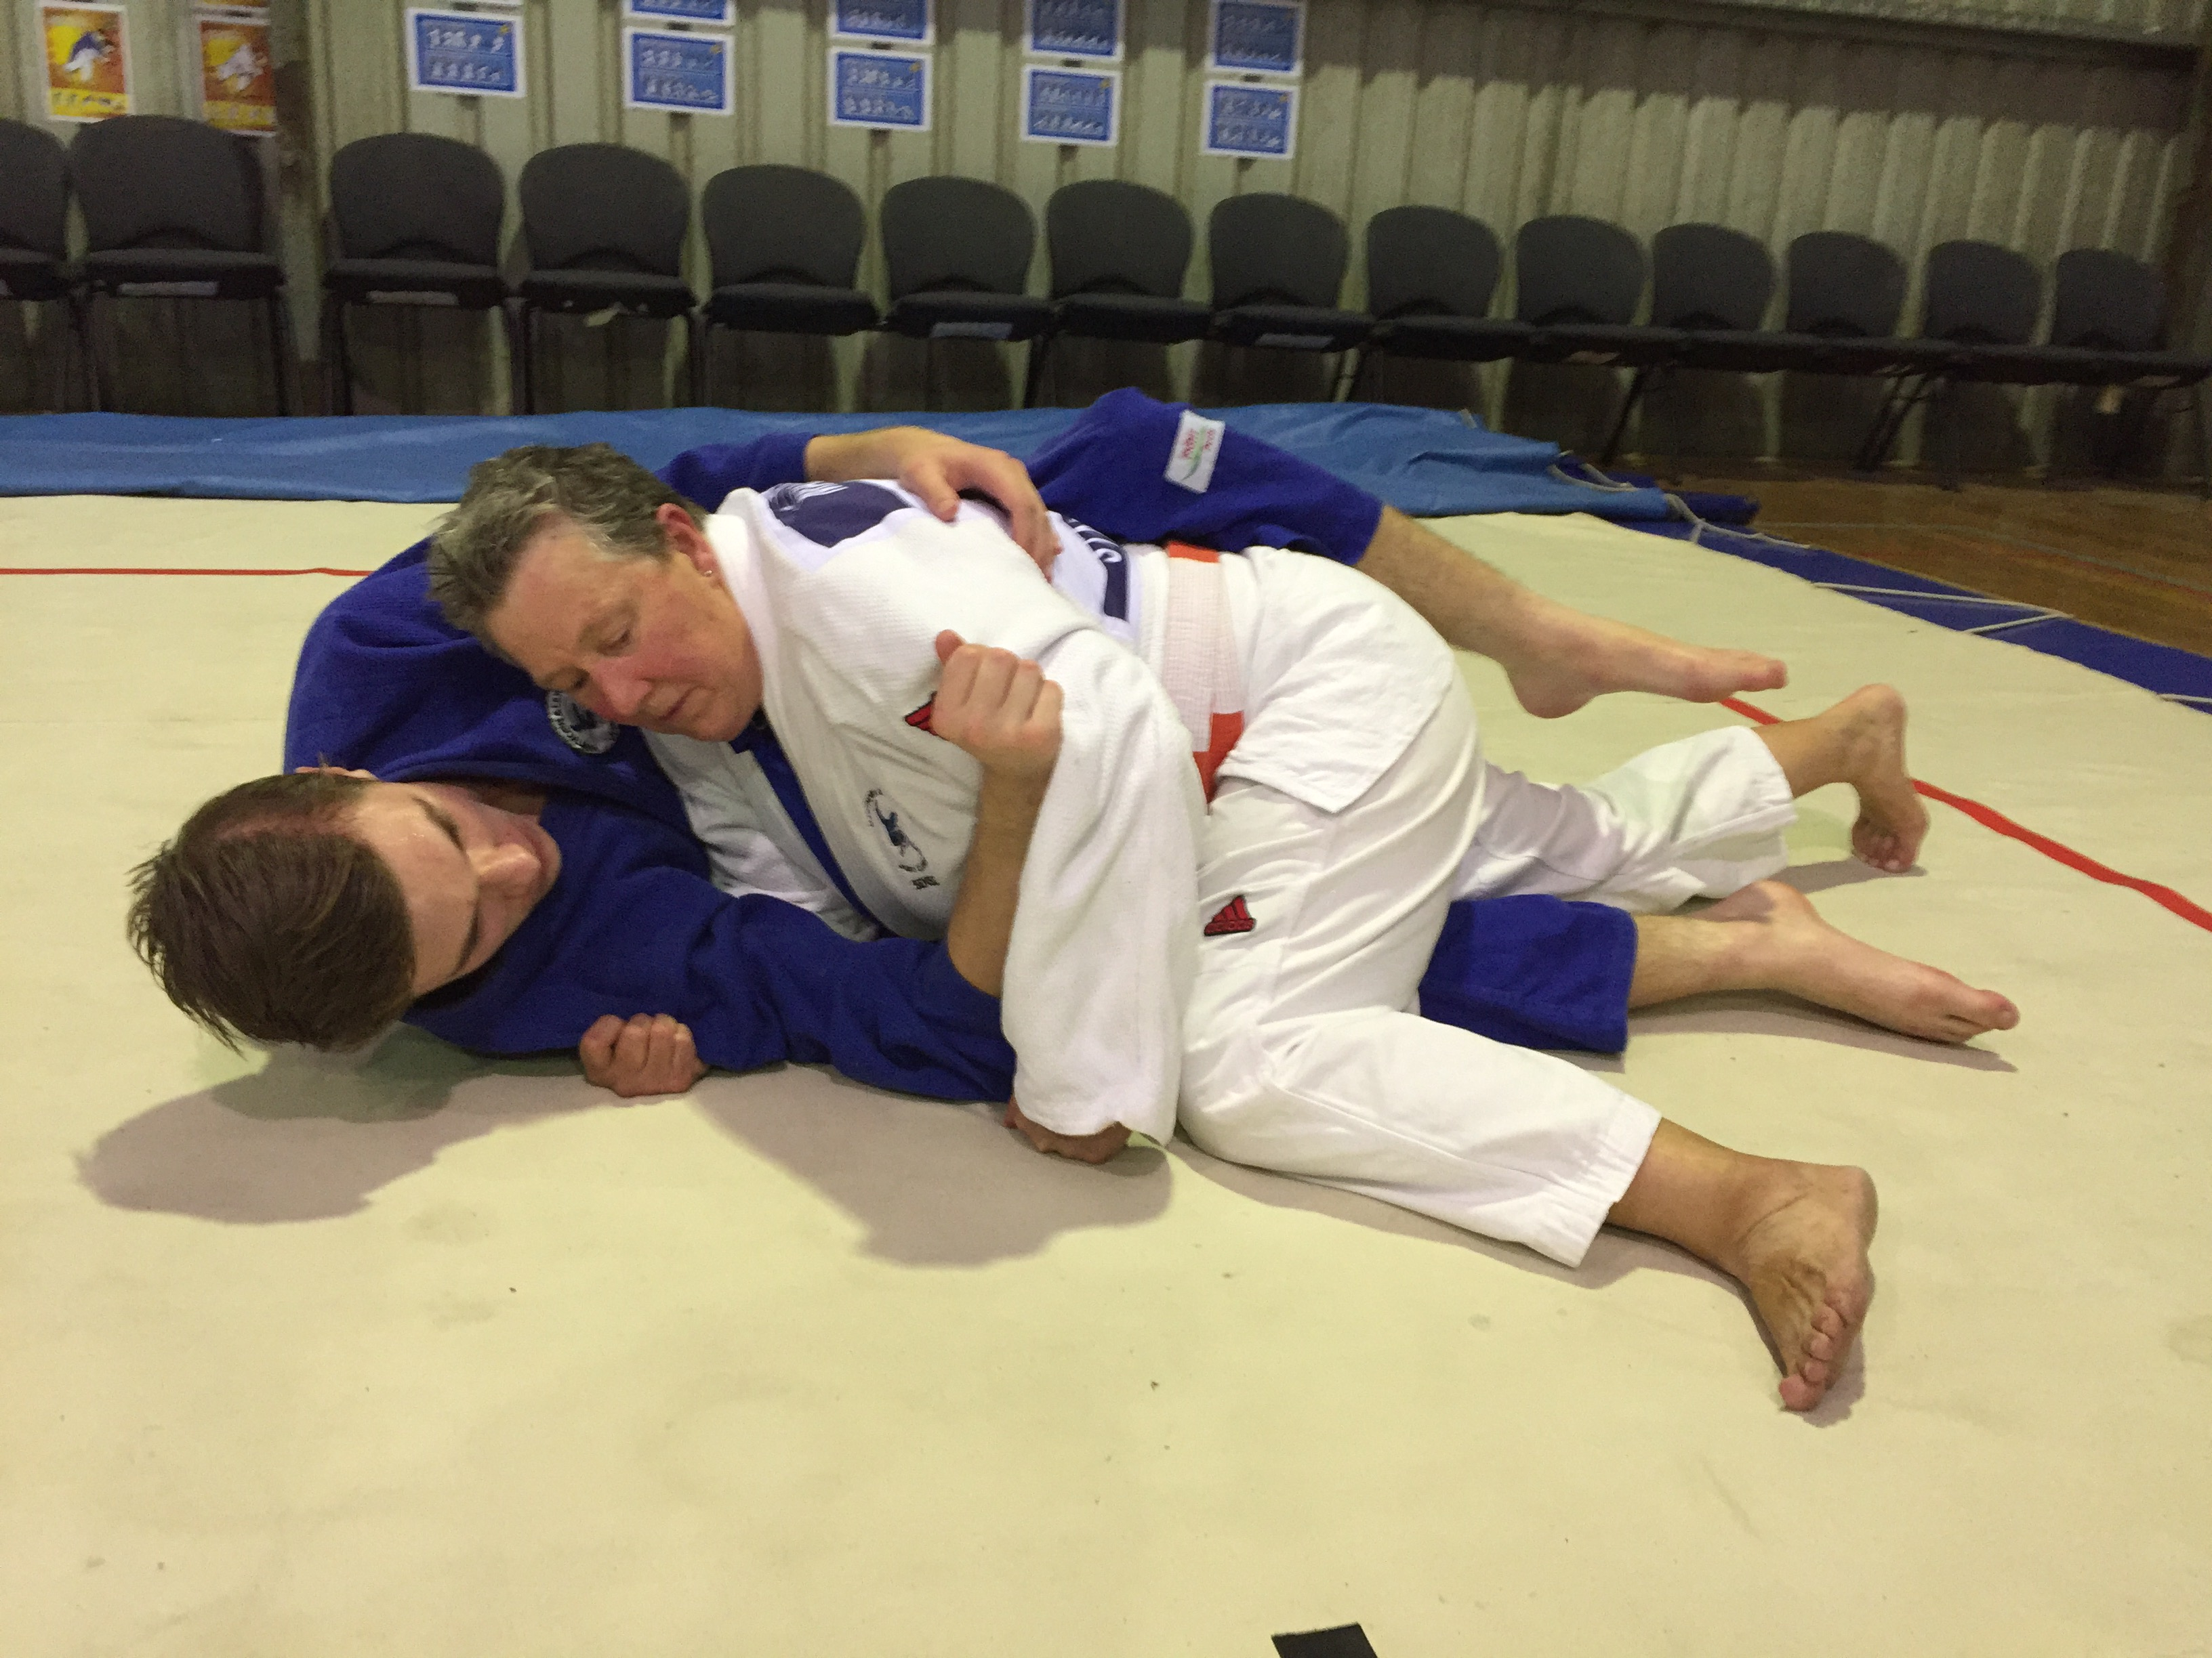
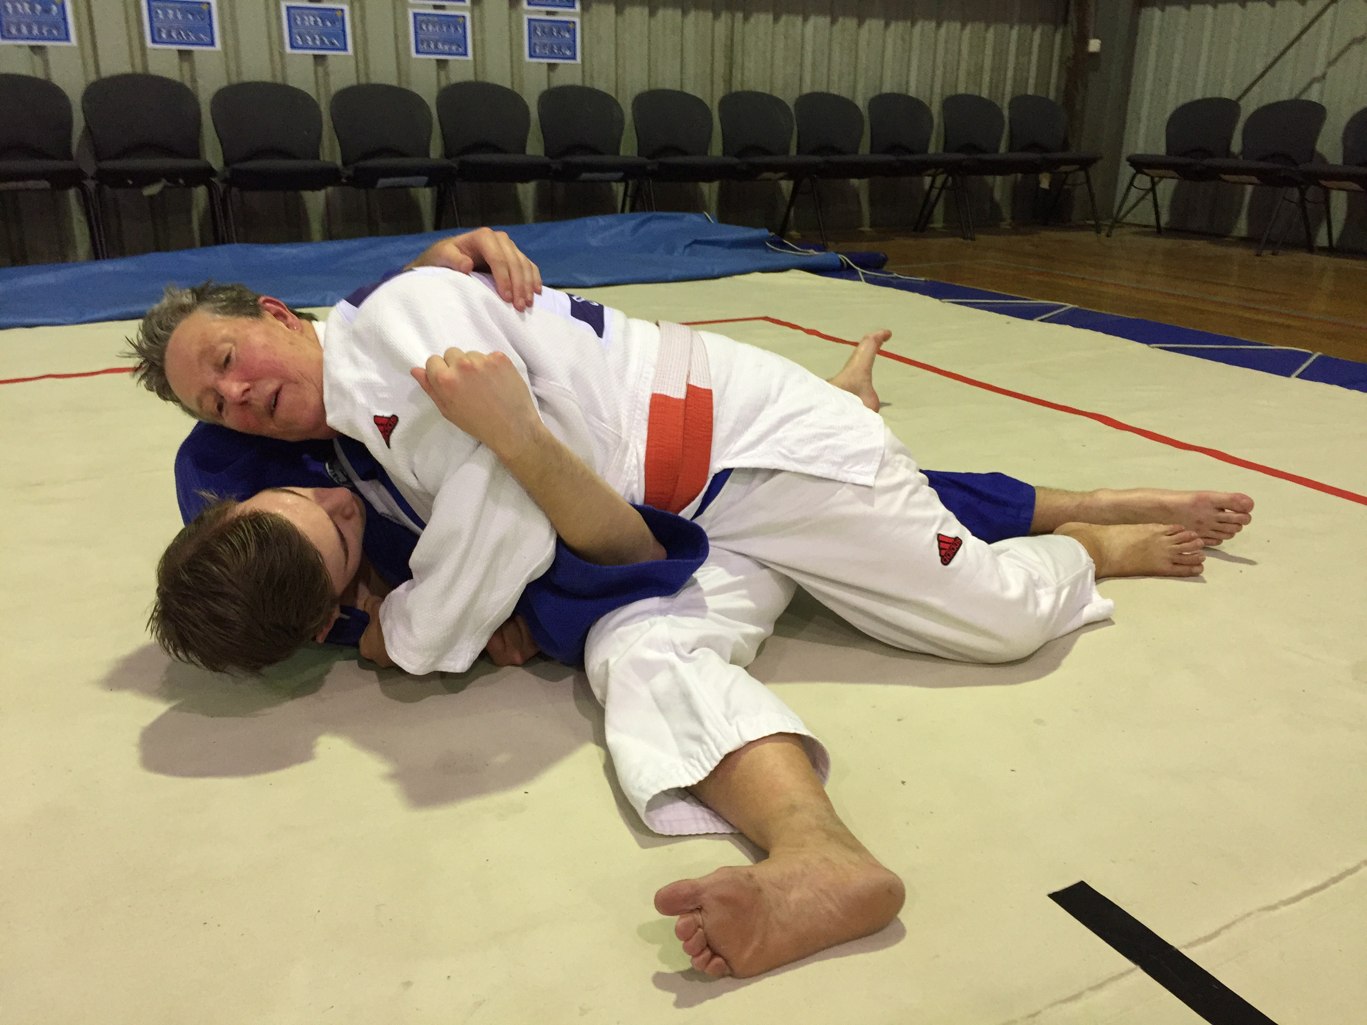
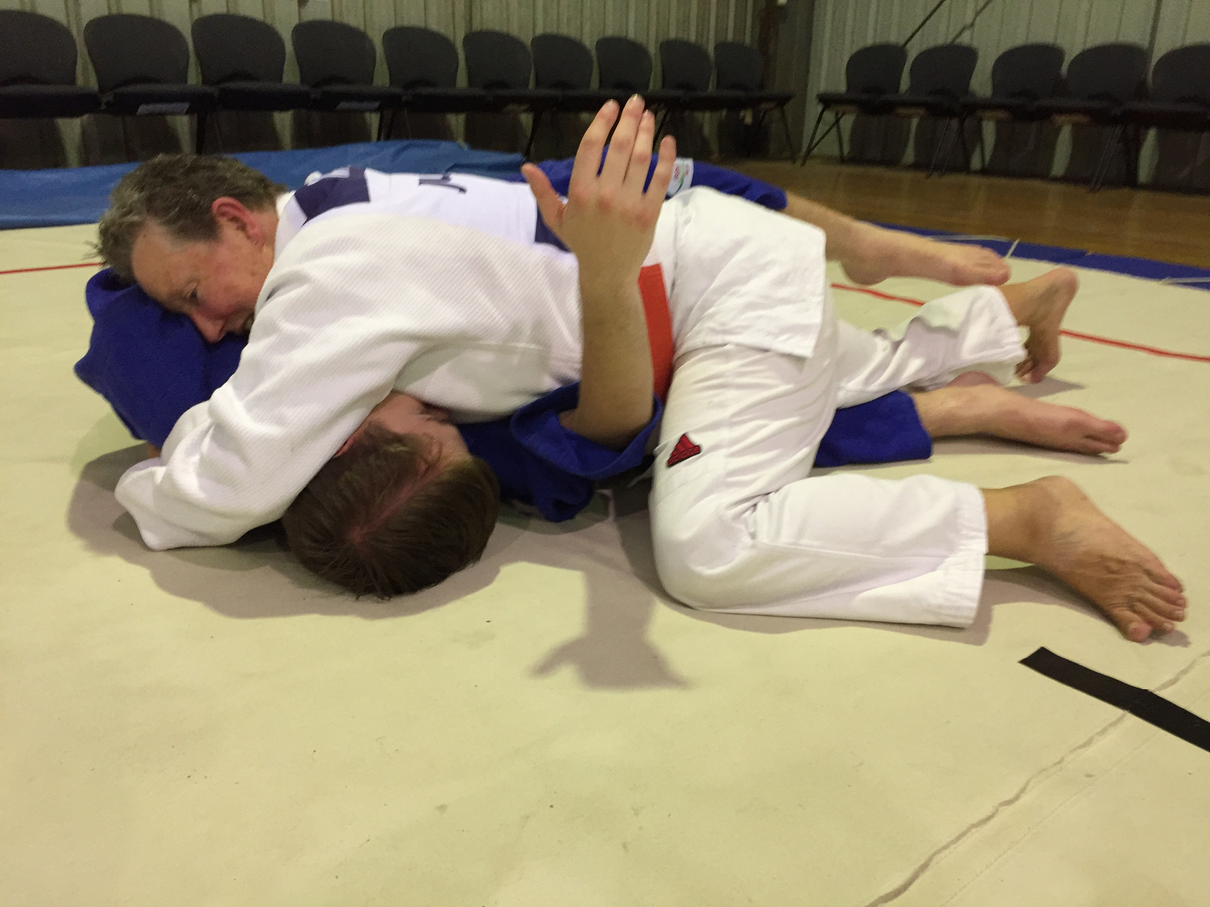
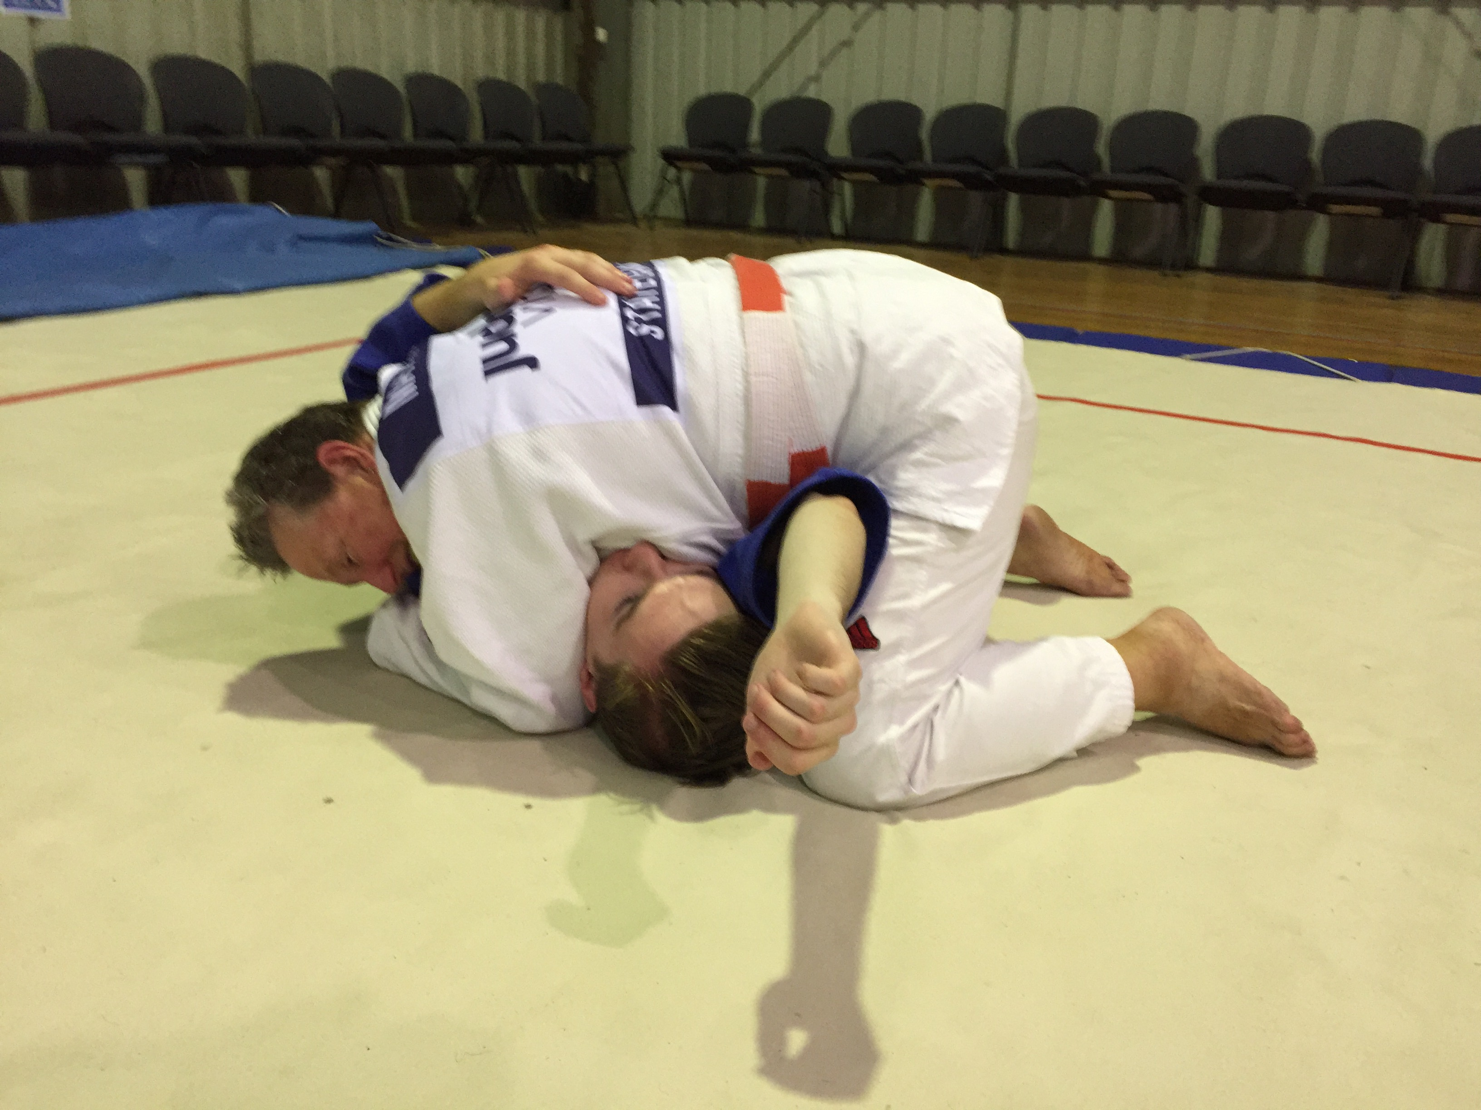
Moving Past The Legs: Fishing
Grab top of shoulder with inside hand, flatten hips and use outside leg to break scissor.
Move other leg to Kesa Gatame position before they scissor your leg and then move into your favourite hold down.

