Slide 1
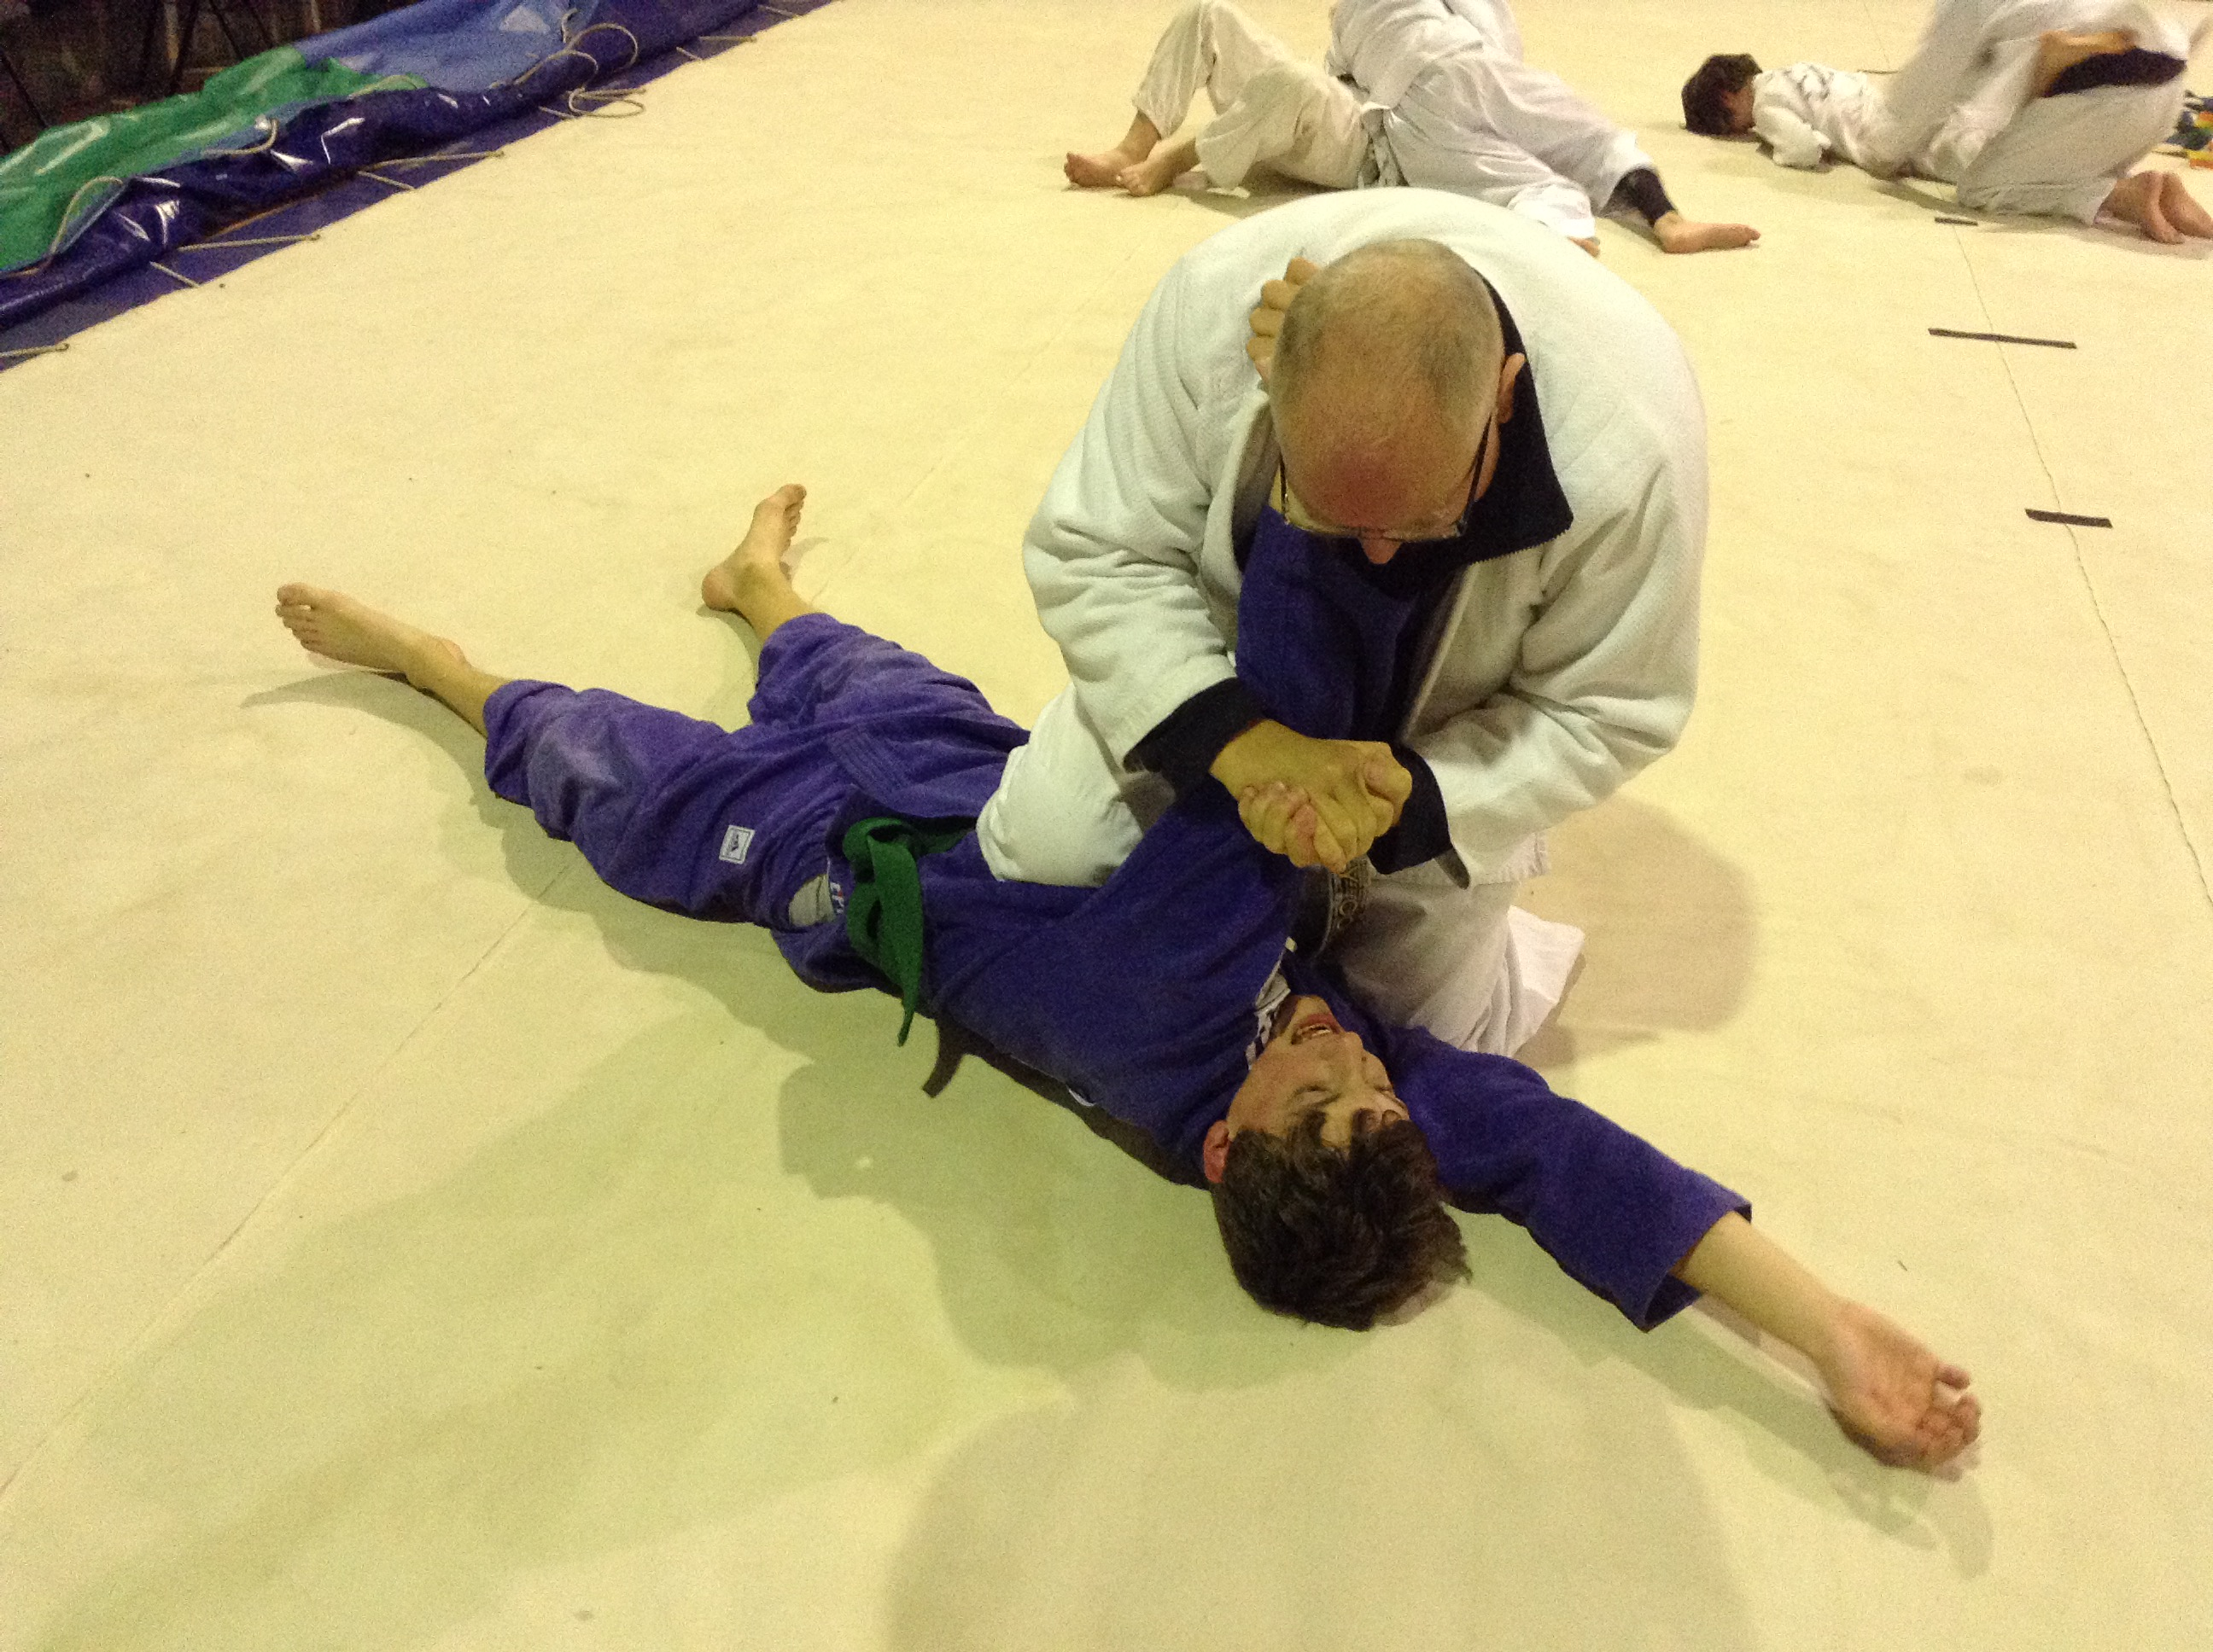
Ude Hishigi Zempaku Gatame Armlock using Forearm
Ude Hishigi Ude Gatame with Hadaka Jime Arms

